Slide 1

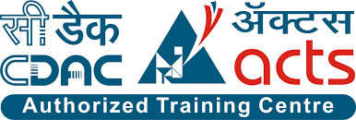
Urban Property Management System
Presented By-
Sujeet Sankadiya(239213)
Hitesh Birla(239158)

Slide 2
Project Introduction
The Urban Property Management System (UPMS) is an innovative solution tailored to address the complexities of managing properties in urban environments. With its user-friendly interface and comprehensive features, UPMS facilitates efficient property management for administrators, property owners, and tenants alike. Users can securely log in using their email IDs and passwords, with role-based access control ensuring appropriate permissions for each user category. Property owners can easily list their flats with detailed descriptions and images, while tenants can browse and book available properties hassle-free
The system also simplifies rent and utility management, allowing tenants to conveniently handle payments online. Built on a solid foundation of four core tables, UPMS ensures data integrity and reliability. Overall, UPMS revolutionizes urban property management, enhancing transparency, accessibility, and efficiency for all stakeholders involved.

Slide 3
Objective (Purpose):
The objective of an Urban Property Management System is to provide a comprehensive and efficient platform for managing urban properties, catering to the needs of property owners, tenants, and administrators. It aims to streamline property management processes, enhance user experience, and optimize financial performance.
By centralizing property listings, lease management, and tenant interactions, the system facilitates easier access to information and improves communication between stakeholders. It enables property owners to effectively market their properties, manage lease agreements, and track rental income and expenses.
For tenants, the system offers an intuitive interface for property search, rental application submission, and online rent payment, thereby simplifying the rental process and improving tenant satisfaction.

Slide 4
Scope:
The scope of an Urban Property Management System encompasses various functionalities and features aimed at facilitating the efficient management of urban properties. Here's a detailed scope:
1. User Authentication and Authorization.
2. User Management.
3. Tenant Management.
4. Rent and Utility Payments.

Slide 5
Technology Used:
Front End: ReactJS
Back End: Java Spring Boot API.
Database: MySQL

Slide 6
S/W and H/W Requirements
Server Side:
Processor: Intel core i5 or above
HDD: 500 GB or above
RAM: 4GB or above
Database: MySQL
Client Side (minimum requirement):
Processor: Intel Dual Core
HDD: Minimum 80GB Disk Space
RAM: Minimum 2GB
OS: Windows 7, Linux

Slide 7
Functionalities - Module wise /user wise
Urban Property Management System consists of two modules named below
Admin
Owner
User/Tenant
User Roles:
Admin: A user with administrative privileges.
Owner: A user who owns one or more properties listed in the system.
User: A regular user who can browse, book, and manage rented properties

Slide 8
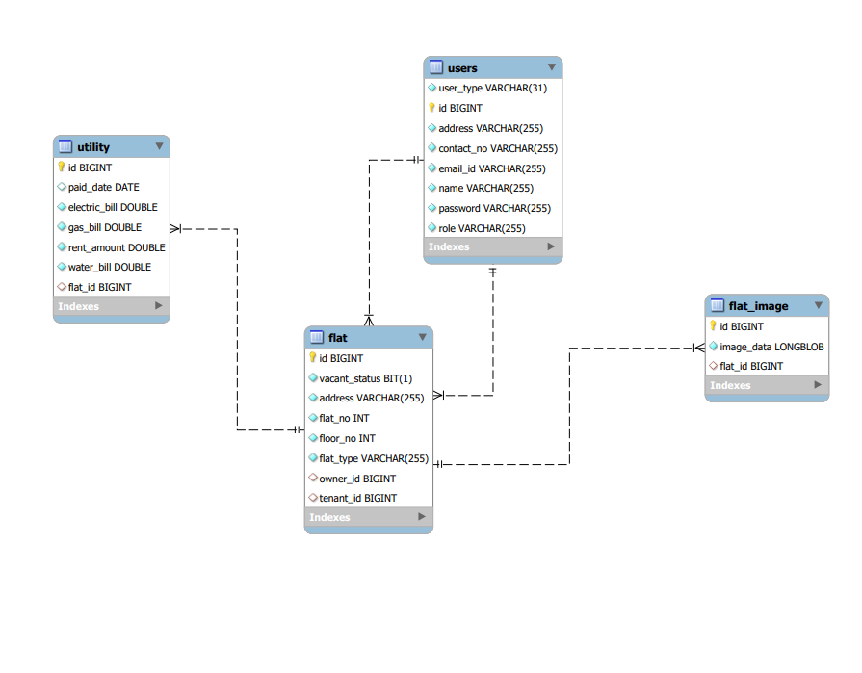
Class Diagram(MySQL Auto generated)

Slide 9
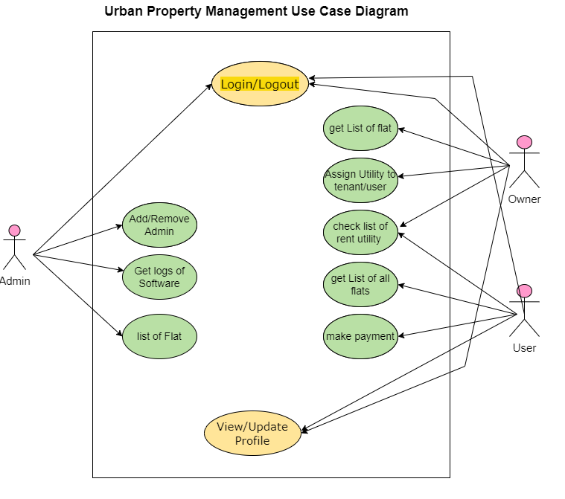
Use Case

Slide 10
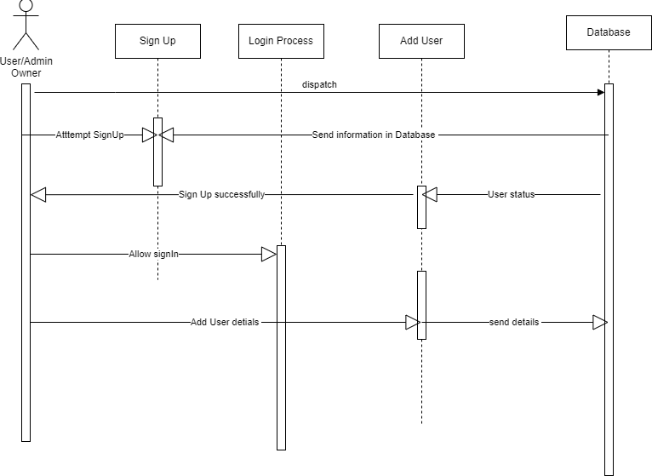
Sequence Diagram

Slide 11
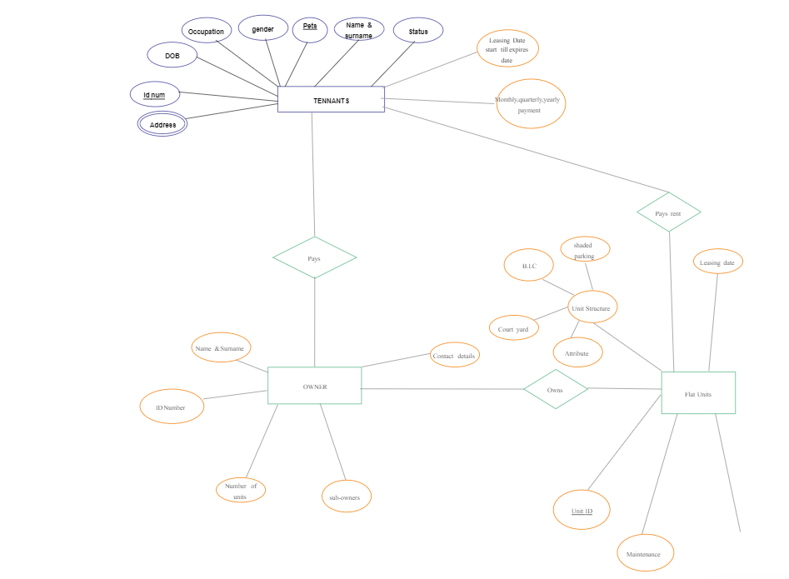
ER Diagram

Slide 12
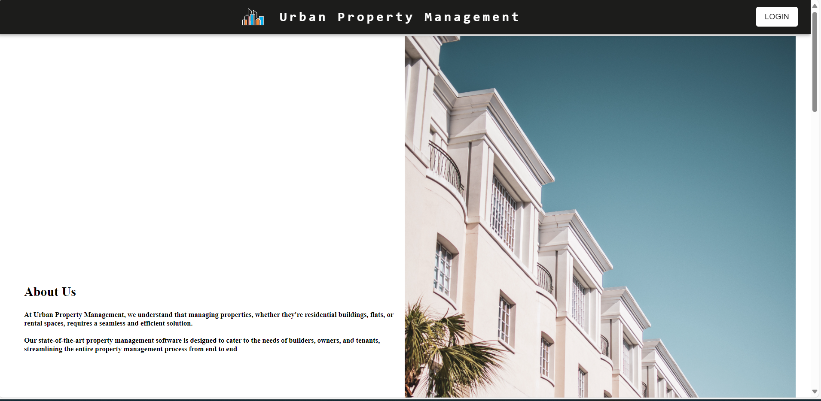
UI
Screen Shots

Slide 13
Futures Scope
This project can be enhanced further by adding more facilities like buying the flat and renting the flat with bond.
This project can be useful to for student to find out the flat with regional rent.
Also we can extend this service providing facility over wide area network .

Slide 14
Conclusion
In conclusion, the urban property management system plays a crucial role in enhancing the livability and attractiveness of urban areas. By prioritizing sustainability, accessibility, and community engagement, stakeholders can work together to create vibrant, resilient, and inclusive cities for generations to come.

Slide 15
References
http://www.google.com
http://www.javatpoint.com/java-tutorial
http://www.w3.org
http://www.wikipedia.org
https://www.tutorialspoint.com/java

Slide 16
THANK YOU

